Slide 1
Intercultural Awareness Training
Sarah McCagherty, Multilingual Student Support (MSS)
camosunmss.opened.ca

Slide 2
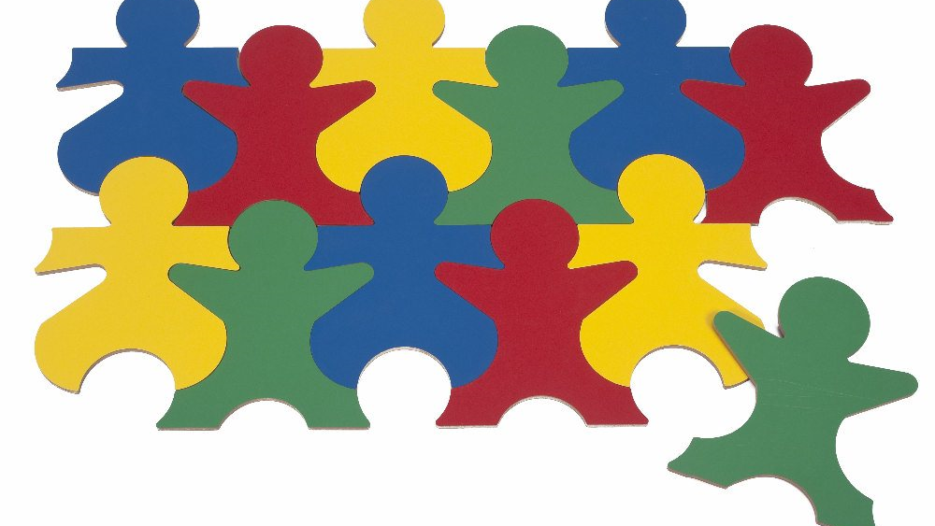
Learning Outcomes
By the end of this training session, participants will:
Appreciate the unique experiences of their peers
Reflect on the nature of both individual and cultural diversity
Consider how cultural characteristics influence values, communication styles, ethical standards, business practices, etc., in different societies

Slide 3
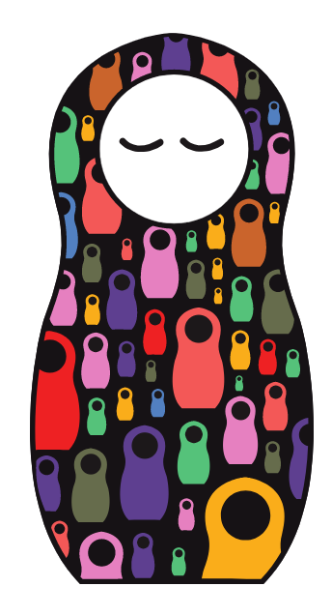
Sharing Our Stories
morethanonestory.org/en/play
Choose one person to share the website
The oldest participant starts
Press "new question“ - read the question out loud
Tell a story - others listen and ask questions
When storyteller is done, game continues clockwise
About 3 minutes per round
Try for 3 rounds (each person tells 2-3 stories)

Slide 4
East Meets West
Go to www.slideshare.net/cyrusinchina/east-meets-west-by-yang-liu/
or Google “East meets west slideshare”
Review the slides. Discuss:
What differences surprise you or stand out?
How might these differences influence the way someone from a “Western” culture interacts with someone from an “Eastern” culture

Slide 5
“Intercultural competence requires the ability to participate in the social life of people who live according to different unwritten rules.”
Gert Jan Hofstede, 2009

Slide 6
- individualist or collectivist perspective; focus on “I” vs. “we”
Individual/ Collective
.
Power Distance
Masculine/ Feminine
Uncertainty Avoidance
Long-Term Orientation
Indulgence/Restraint
- free gratification vs. suppression and strict norms
Hofstede’s Cultural Dimensions
- acceptance of hierarchy (vs. egalitarian)
- long-term outcomes vs. short term pragmatism
- achievement and power vs. cooperation and nurture
- degree of comfort with uncertainty and ambiguity
These are NOT rules
→ Cultural groups, NOT individuals

Slide 7
Hofstede Country Comparison
Go to www.hofstede-insights.com/country-comparison/
or Google “Hofstede country comparison”
Compare 2 countries, review their scores and analysis, and write a brief summary. Consider:
Key differences and similarities
How might these qualities shape interactions between people in these cultures?

Slide 8
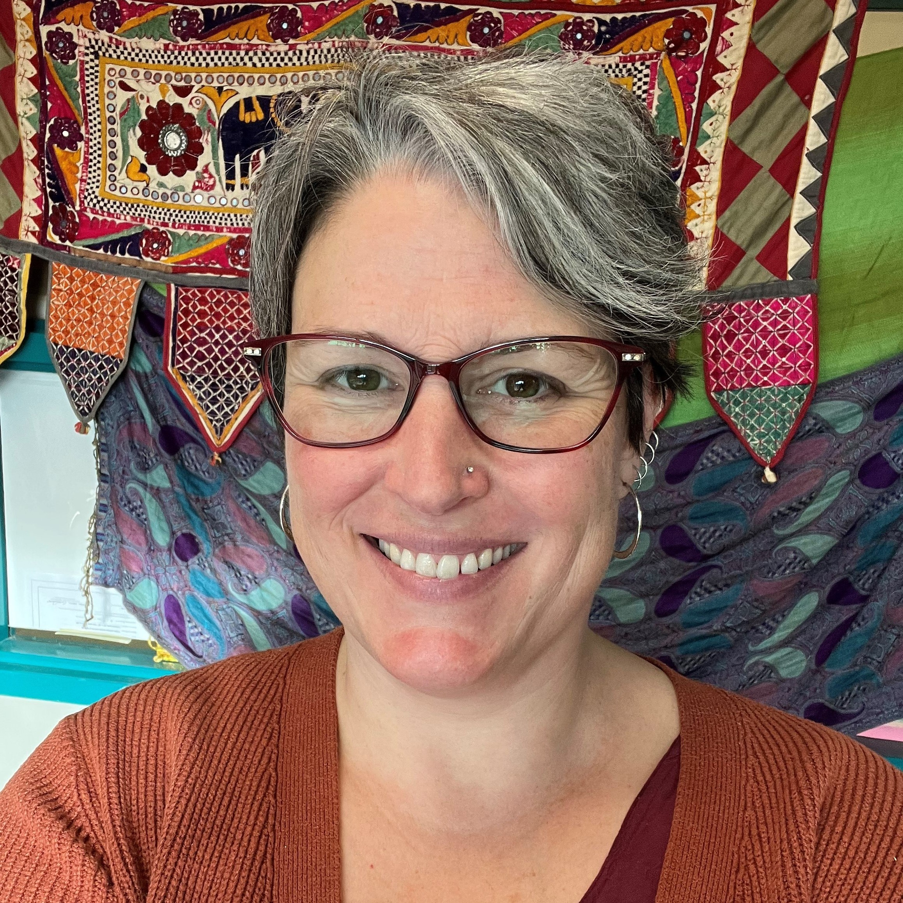
THANK YOU! Questions or comments? Please email Sarah.
Sarah McCagherty: mccaghertys@camosun.ca
Camosun MSS website: camosunmss.opened.ca
Contact the MSS for the School of Health & Human Services, Sarah McCagherty, or check out the Camosun Multilingual Student Support (MSS) website to find out how the MSS team can support you.

